Slide 1


Storage Nepal
Storage Nepal
Flexible, Secure, and Cost-Effective Self Storage Solutions
Explore More
Sanjay Khanal

Slide 2

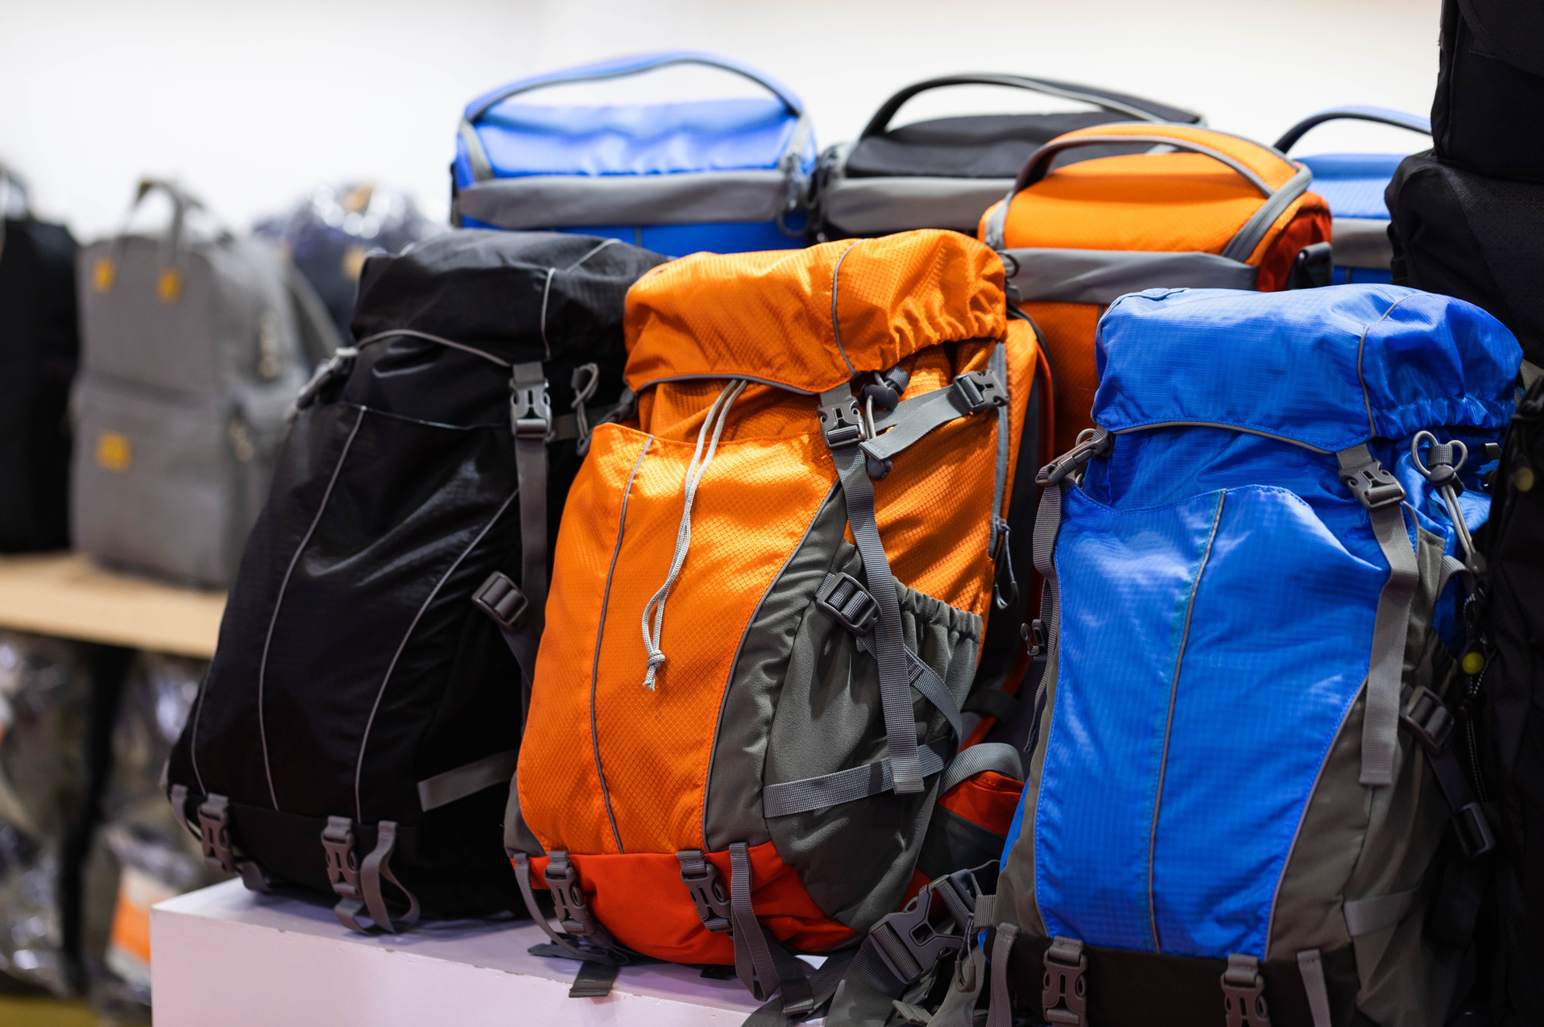

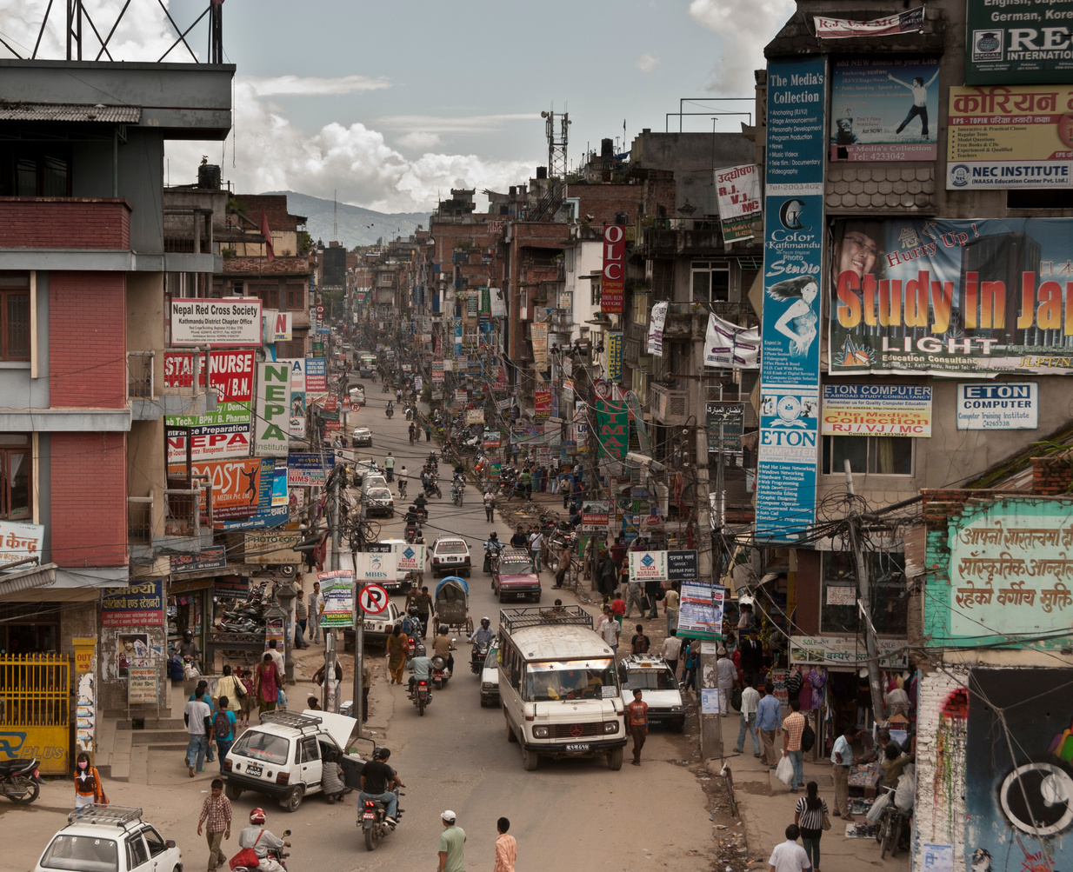
Storage Nepal
Few Thoughts!
www.reallygreatsite.com
Have you ever struggled to find space to store your belongings while moving?
A Brief Story About The Problems
As a tourist, wouldn't it be convenient to have a safe place to store your luggage while exploring other parts of the country?
With cities like Kathmandu rapidly urbanizing, how will the businesses adapt to the space crunch?
How can small businesses afford to sell their products affordably on time besides their place of operation?
2028

Slide 3
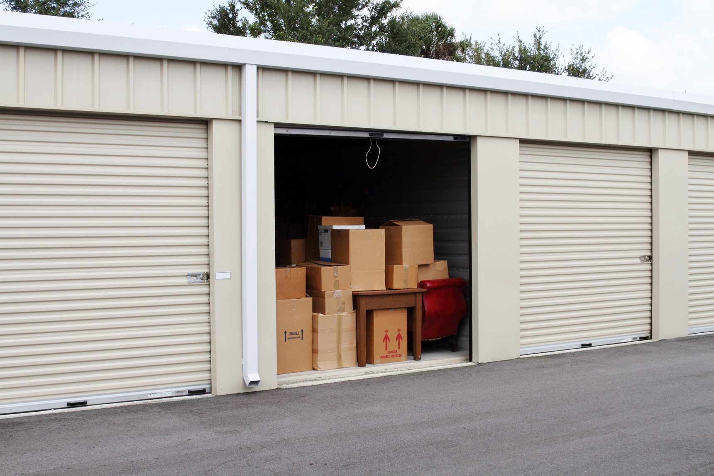
Storage Nepal
Vision
To become the leading self storage solution provider in urbanizing regions of Nepal
Mission
Address the storage needs of diverse customer segments, including retail shops, individuals moving temporarily, small factories, wholesalers, offices, and tourists.
Storage Nepal aims to provide flexible, secure, and cost-effective storage solutions.
2028

Slide 4


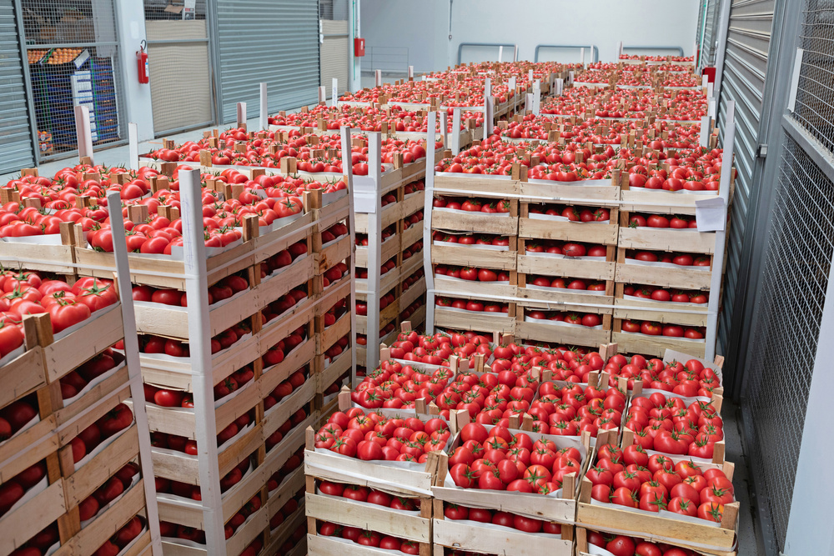


Storage Nepal
Target Market Segments
Individuals Moving Temporarily
Small Factories and Wholesalers
Secure storage for personal belongings
Efficient warehousing solutions
CMO
Retail Shops
Offices
Tourists
Off-site storage for excess inventory
Storage for supplies, old equipment, and documents
Safe luggage storage during travel

Slide 5
Business Model Canvas
Storage Nepal
KEY PARTNERS
KEY ACTIVITIES
VALUE
PROPOSITIONS
CUSTOMER
RELATIONSHIPS
CUSTOMER
SEGMENTS
Real Estate Providers
Security Firms
Transport Companies
Marketing Agencies
Travel Agencies, hotels
Facility Mgmt
Customer Service
Marketing & Sales
Logistics
Technology Mgmt
Flexible Storage Options
Competitive Pricing
High Security
Convenience
Tourist Support
Personal Assistance
Online Platform
Loyalty Programs
Retail Shops
Individuals
Small Factories
Wholesalers / Distributors
Offices
Tourists
KEY RESOURCES
CHANNELS
Storage Facilities
Technology
Staff
Vehicles
Online
Partners - travel, hotel
Direct Marketing - airports
Social Media
COST STRUCTURE
REVENUE STREAMS
Facility Costs - Rent, maintenance, security
Staff Salaries
Technology Costs
Marketing Expenses
Transport Costs
Storage Fees
Value-added Services - transport, insurance

Slide 6
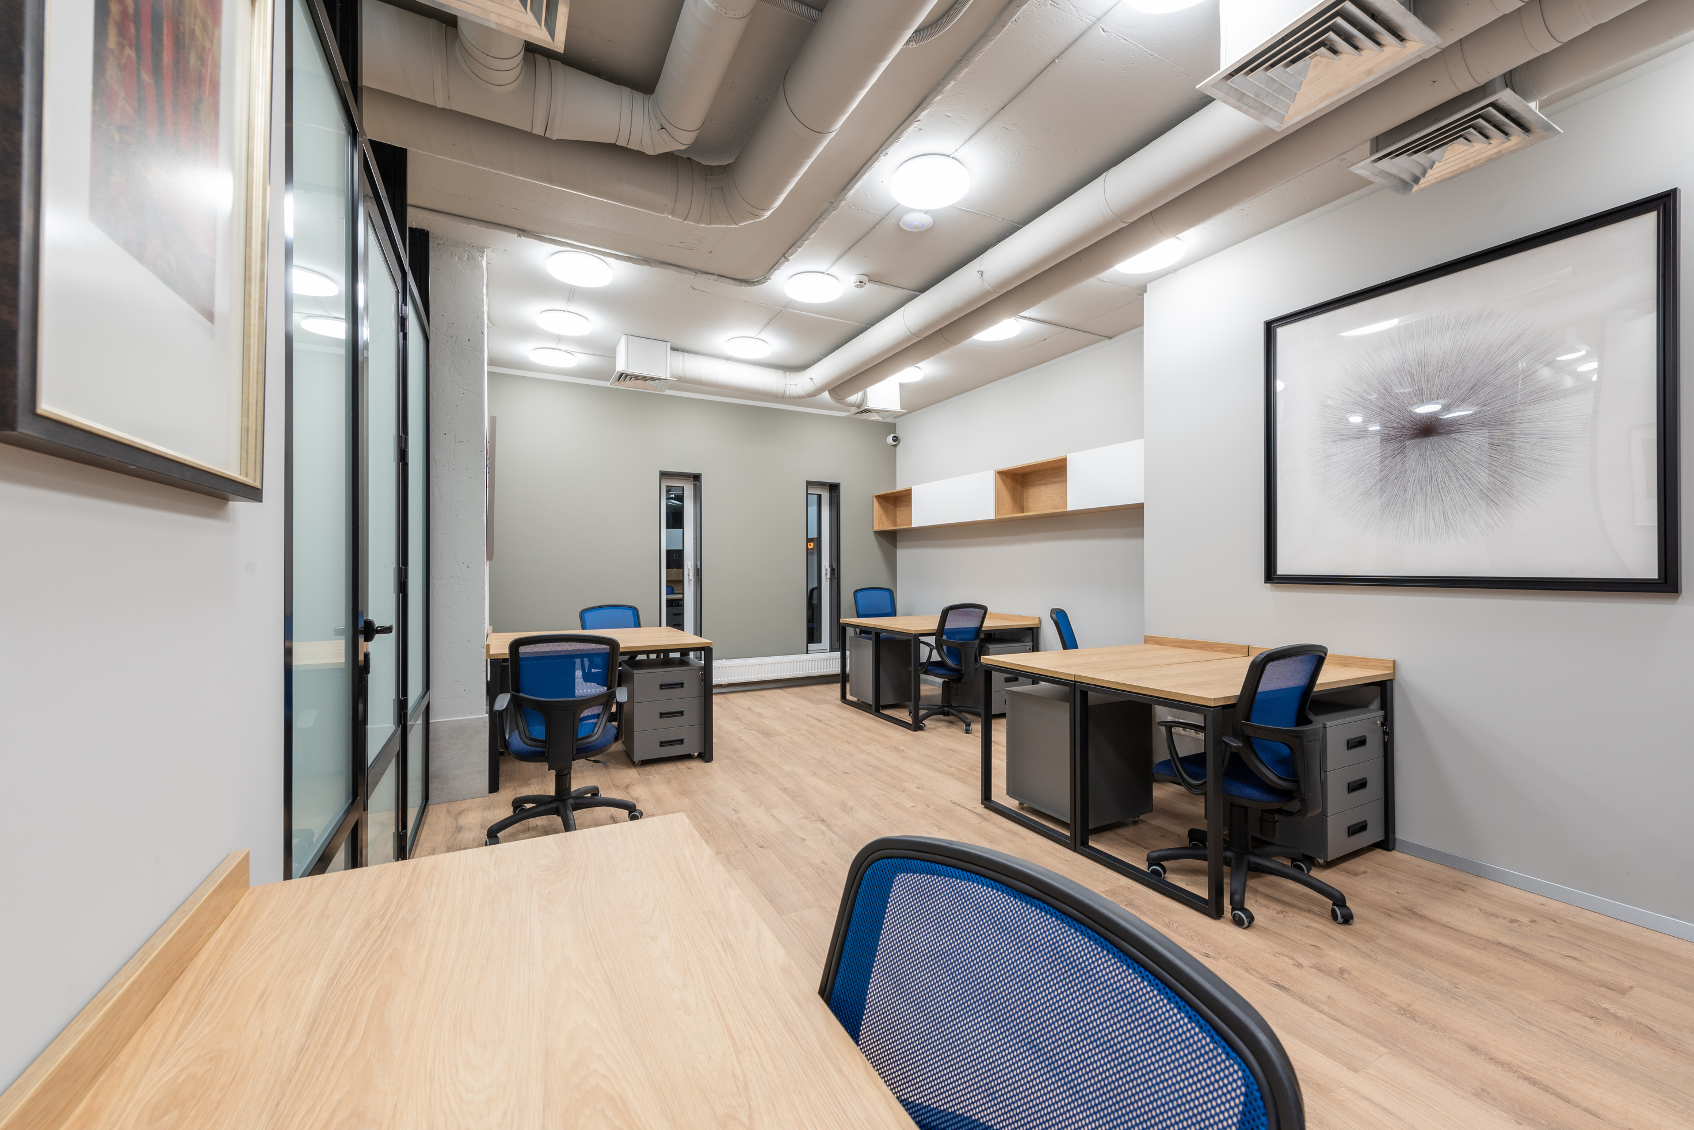
Storage Nepal
Operations Strategy
Location & Setup
Management
Strategic locations in Kathmandu.
Local contractors for construction.
Advanced security systems with 24/7 CCTV monitoring.
Trained local staff, including facility managers and security personnel.
Daily operations overseen by a dedicated team.
Human Resources
Facility managers, customer service representatives, security personnel, logistics coordinators.
Recruitment: Local hiring, job portals, employee referrals.
Training: Comprehensive onboarding, continuous training, mentorship program.

Slide 7
Storage Nepal
Marketing Strategy
Market Segmentation
Value Proposition
Retail shops, individuals moving temporarily, small factories, offices, tourists
Flexible storage solutions, competitive pricing, high security, convenience, tourist support
Content Marketing
Blog and articles, customer testimonials
Channels
Channels
Online presence (website, mobile app), social media, SEO & SEM.
Partnerships with travel agencies, hotels, real estate agents, and local businesses
Online presence (website, mobile app), social media, SEO & SEM.
Partnerships with travel agencies, hotels, real estate agents, and local businesses

Slide 8

Storage Nepal
Financial Projection
Year I
Starting Cash: NPR 5,000,000
Investor Funds: NPR 10,000,000
Loans: NPR 15,000,000
Personal Funds: NPR 2,000,000
Incoming Cash from Sales: NPR 8,000,000 (projected)
Expenditure: NPR 32,000,000
Year II
Incoming Cash from Sales: NPR 12,000,000 (projected)
Expenditure: NPR 19,400,000

Slide 9
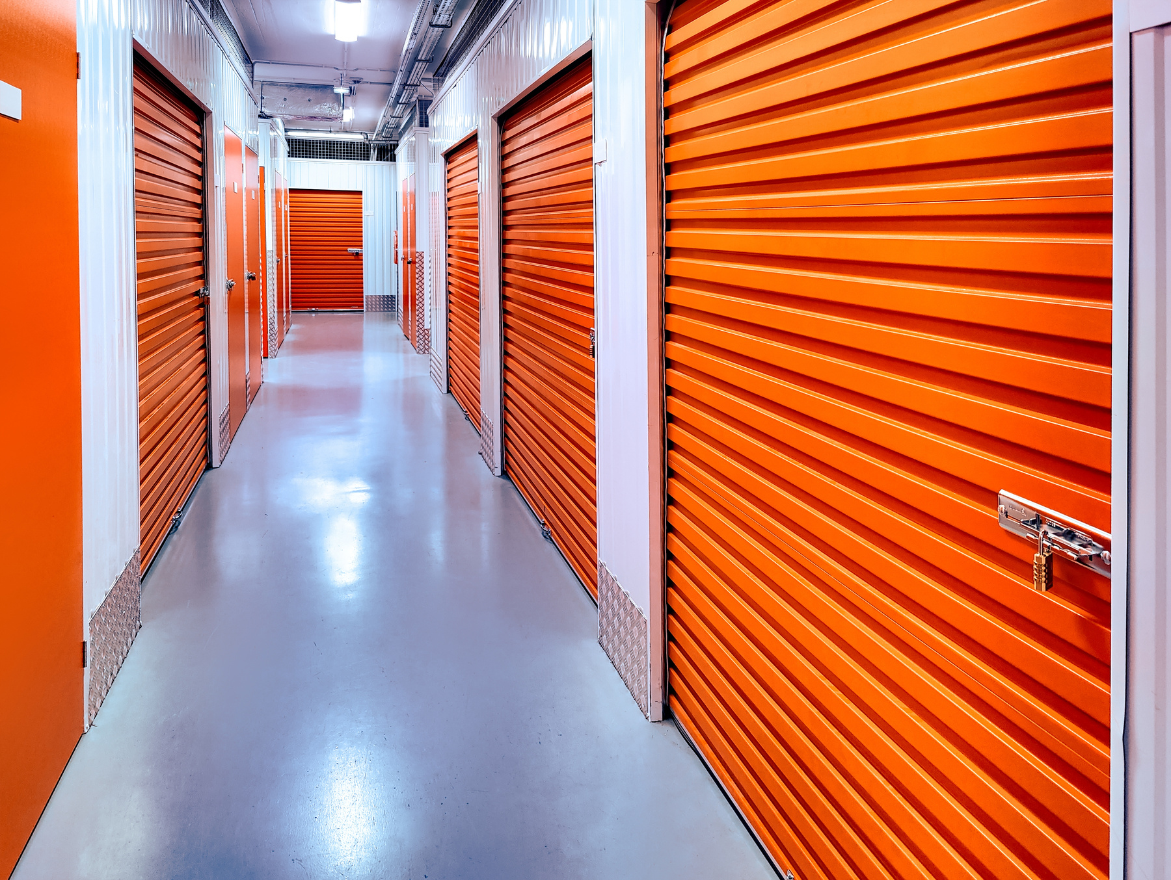
Storage Nepal
Conclusion
Storage Nepal is strategically positioned to meet the growing demand for storage solutions in Nepal’s rapidly urbanizing regions. By offering flexible, secure, and cost-effective storage options, we address the critical needs of various customer segments, including retail shops, individuals moving temporarily, small factories, wholesalers, offices, and tourists.
With a sustainable and profitable business model, strong market potential, and a commitment to exceptional customer service, Storage Nepal aims to establish a strong market presence and achieve long-term success in the storage industry.

Slide 10
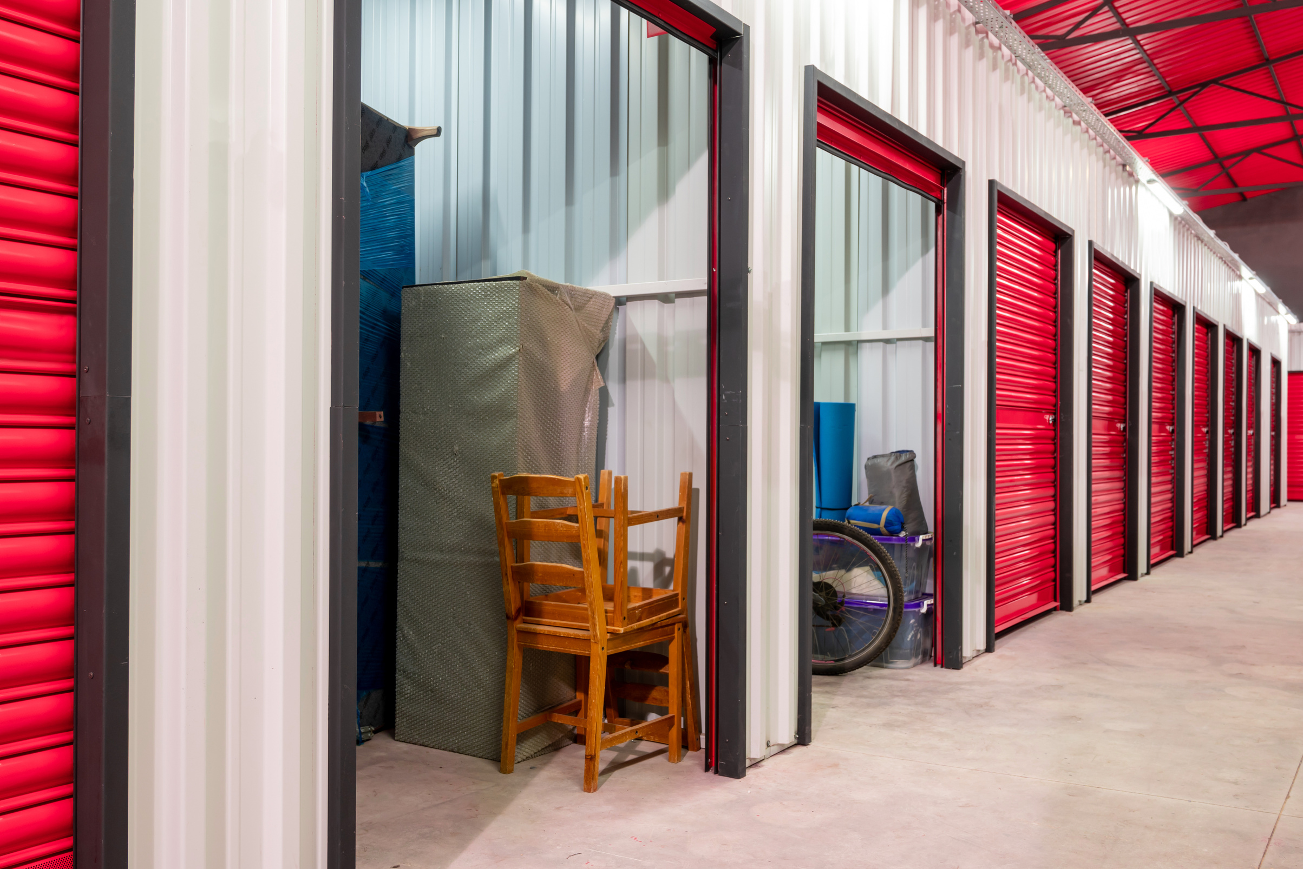


Storage Nepal
Thank You
Contact For Collaboration
Address
Telephone
Khumaltar, Lalitpur, Nepal
+977 9842506791

